Slide 1

Notes:
Cover Slide

Slide 2

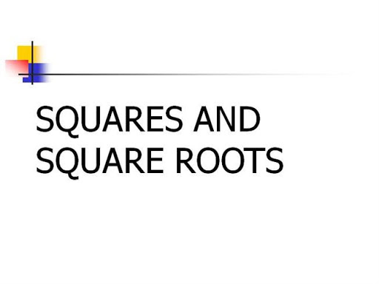

Topic Name
Notes:
Content can be added in this slide and can duplicate the same slide if there is a need of slide.

Slide 3
STEPS TO FIND SQUARE ROOT OF A NUMBER :
Step 0: Check if the given number is a perfect square. > The number cannot end with {2,3,7,8} > Digital sum is always {0,1,4,7,9}
Step 1: First of all group the number in pairs of 2 starting from the right.
Step 2: To get the tens place digit, Find the nearest square (equivalent or greater than or less than) to the first grouped pair from left and put the square root of the square.
Step 3: To get the unit’s place digit of the square root
If the number ends in | Unit’s place digit of the square root
1 | 1 or 9(10-1)
4 | 2 or 8(10-2)
9 | 3 or 7(10-3)
6 | 4or 6(10-4)
5 | 5
0 | 0

Slide 4
Question: 01
Which of the following numbers is a perfect square?
141
196
124
222
Answer: B

Slide 5
Explanation:
(11.874)^2=141
(14)^2=196
(11.135)^2=124
(14.89)^2=222

Slide 6
Question: 02
What least number must be added to 6072 to make it a perfect square?
6
10
12
16
Answer: C

Slide 7
Explanation:
In order to make 6072 a perfect square, we need to find the nearest square number to 6072.
To find the nearest square number, take square root of 6072
√(6072)=77.9230
So, the nearest square number to 6072 is 78^2=6084
Now, to calculate the least number, subtract 6072 from 6084,
So, the lowest number to be added to 6072 is = 6084 – 6072 = 12
Hence, to make 6072 a perfect square, 12 is to be added.

Slide 8
Question: 03
The value of {√10+[√25+(√108+(√154+(√225 )))]} is
4
6
8
10
Answer: A

Slide 9
Explanation:
{√10+[√25+(√108+(√154+(√225 )))]}
{√10+[√25+(√108+(√154+15))]}
{√10+[√25+(√108+(√169))]}
{√10+[√25+(√108+13)]}
{√10+[√25+(√121)]}
{√10+[√25+11]}
{√10+[√36]}
{√10+6}====>√16=4

Slide 10
Question: 04
The value of √(0.01)+√(0.81)+√(1.21)+(√0.0009) is
2.03
2.13
2.07
2.8
Answer: B

Slide 11
Explanation:
= √(0.01)+√(0.81)+√(1.21)+(√0.0009)
=√(1/100)+√(81/100)+√(121/100)+√(9/10000)
= (1/10)+(9/10)+(11/10)+(3/100)
= 0.1+0.9+1.1+0.03
= 2.13

Slide 12
Question: 05
What should come in place of both X in the equation (X/√162)=(√128/X)
12
14
144
132
Answer: A

Slide 13
Explanation:
(X/√162)=(√128/X)
x² = √(128 x 162)
= √(64 x 2 x 18 x 9)
= √(8² x 6² x 3²⁾
= 8 x 6 x 3
= 144.
x = 144 = 12.

Slide 14
Question: 06
The least perfect square, which is divisible by each of 21, 36 and 66 is
:
213444
214344
214434
231444
Answer: A

Slide 15
Explanation:
L.C.M. of 21, 36, 66 = 2772.
Now, 2772 = 2 x 2 x 3 x 3 x 7 x 11
To make it a perfect square, it must be multiplied by 7 x 11.
So, required number = 2² x 3² x 7² x 11² = 213444

Slide 16
Question: 07
If 3√5 + √125 = 17.88, then what will be the value of √80 + 6√5 ?
13.41
20.46
21.66
22.35
Answer: D

Slide 17
Explanation:
3√5 + √125 = 17.88
3√5 + √(25 x 5) = 17.88
3√5 + 5√5 = 17.88
8√5 = 17.88
√5 = 2.235
√80 + 6√5 = √(16 x 5) + 6√5
= 4√5 + 6√5
= 10√5 = (10 x 2.235) = 22.35

Slide 18
Question: 08
A group of students decided to collect as many paise from each member of group as is the number of members. If the total collection amounts to Rs. 59.29, the number of the member is the group is:
57
67
77
87
Answer: C

Slide 19
Explanation:
Money collected = (59.29 x 100) paise = √5929 paise.
Number of members = √5929 = 77.

Slide 20
Question: 09
If √5 = 2.236, then the value of (√5/2)-(10/√5)+ √125 is equal to:
5.59
7.826
8.944
10.062
Answer: B

Slide 21
Explanation:
= (√5/2)-(10/√5)+ √125
= (2.236/2)-(10/2.236)+(5*2.236)
= 1.118-4.47227191+91.18
= 7.8257

Slide 22
Question: 10
√(0.0169 x ?) = 1.3
10
100
1000
None of these
Answer: B

Slide 23
Explanation:
Let √(0.0169 * X)= 1.3.
Then, 0.0169X = (1.3)² = 1.69
x =1.69/0.0169= 100

Slide 24
Question: 11
The square root of 64009 is:
253
347
363
803
Answer: A

Slide 25
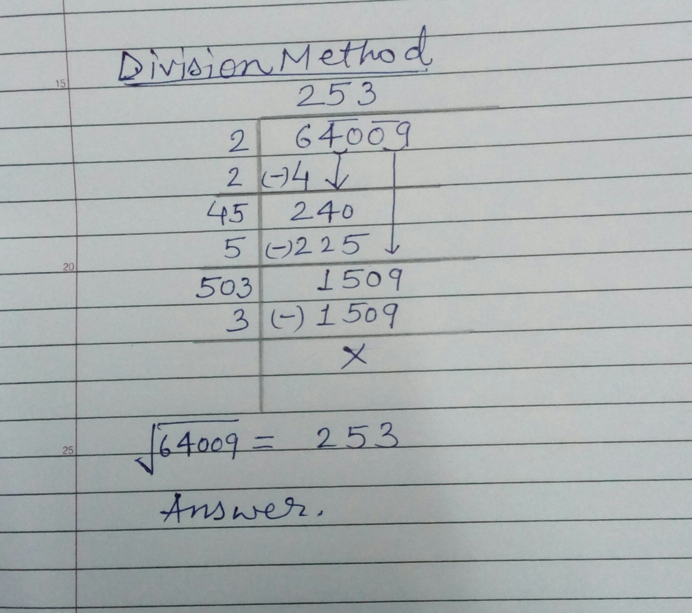
Explanation:

Slide 26
Question: 12
If √ 1369 = 37 then what is √13.69 + √0.1369 + √ 0.001369 + √ 0.00001369?
4.0021
4.1107
3.1232
2.1323
Answer: B

Slide 27
Explanation:
√13.69 + √0.1369 + √ 0.001369 + √ 0.00001369
= √(1369 / 100) + √(1369/ 10000) + √(1369/ 1000000) + √(1369/ 100000000)
= √1369 / √100 + √1369 / √10000 + √1369 / √1000000 + √1369 / √100000000
= 37/10 + 37/100 + 37/1000 + 37/ 10000
= 3.7 + 0.37 + 0.037 + 0.0037
= 4.1107

Slide 28
Question: 13
If √1+25/144 = (1+ x/12), then the value of x is .
1
2
5
9
Answer: A

Slide 29
Explanation:
= √1+25/144 = (1+ x/12)
= √169/144 = (1+x/12)⇒ (1+x/12) = √169/144 =13/12 ⇒ x/12
= (13/12-1)= 1/12
⇒ x=1

Slide 30
Question: 14
112/ √196 * √576/12 *√256/8 =?
8
12
16
32
Answer: D

Slide 31
Explanation:
Given Exp
112/ √196 * √576/12 *√256/8 =?
= (112/14)*(24/12)* (16/8)
=(8*2*2)
= 32

Slide 32
Question: 15
If √841 = 29, then √0.00000841 = ?
0.00029
0.0029
0.029
0.29
Answer: B

Slide 33
Explanation:
Given
√841 = 29
√0.00000841 = √841/100000000
= 29/10000
= 0.0029

Slide 34








/ethnuscodemithra
Ethnus Codemithra
/ethnus
/code_mithra
THANK YOU
https://learn.codemithra.com/
codemithra@ethnus.com
+91 7815 095 095
+91 9019 921 340

